Slide 1

Problem Solving Using Computer
Course Code: BCAC 0018
Lecture - 4
Course: BCA I Year I Semester
By: Mr. Sanjiv Agrawal
Sanjiv.agrawal@gla.ac.in
+91-8923015116

Slide 2
Classification of Computers:
Based on Different Criteria
According to Purpose
  General Purpose Computers
  Special Purpose Computers
According to Technology Used
  Analog Computers
  Digital Computers
  Hybrid Computers
According to Size and Capacity
  Supercomputer
  Mainframe Computer
  Minicomputer
  Microcomputer

Slide 3
According to Purpose
1. General Purpose Computers:
Computers that follow instructions for general requirements such as sales analysis, financial accounting, invoicing, inventory, management information etc. are called General Purpose Computers.
Almost all computers used in offices for commercial, educational and other applications are general purpose computers.
2. Special Purpose Computers:
Computers designed from scratch to perform special tasks like scientific applications and research, weather forecasting, space applications, medical diagnostics etc. are called Special Purpose Computers.

Slide 4
According to Technology Used
1. Analog Computers:
Analog computers are special purpose computers that represent and store data in continuously varying physical quantities such as current, voltage or frequency.
These computers are programmed for measuring physical quantities like pressure, temperature, speed etc. and to perform computations on these measurements.
Analog computers are mainly used for scientific and engineering applications. Some of the examples of analog computers are given below:
(i) Thermometer: It is a simple analog computer used to measure temperature.
(ii) Speedometer: Car's speedometer is another example of analog computer where the position of the needle on the dial represents the speed of the car.

Slide 5
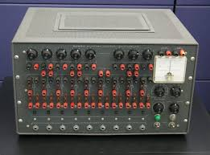

Slide 6
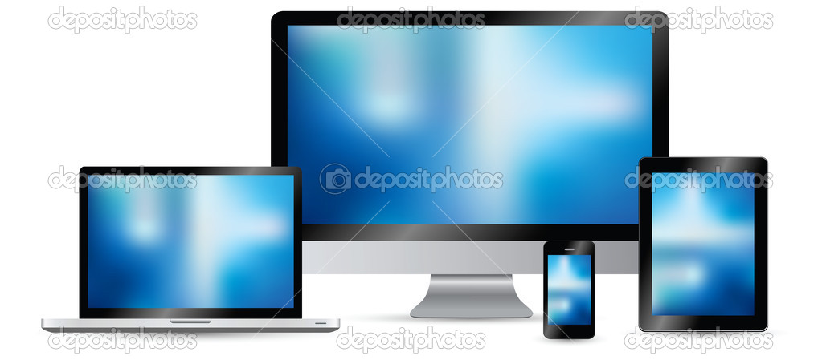
2. Digital Computers:
Digital computers are mainly general purpose computers that represent and store data in discrete quantities or numbers.
In these computers, all processing is done in terms of numeric representation (Binary Digits) of data and information.
Although the user enter data in decimal or character form, it is converted into binary digits (0's and l's).
Almost all the computers used nowadays are digital computers and we will discuss the detailed working and components of these computers in subsequent sections of this unit.

Slide 7
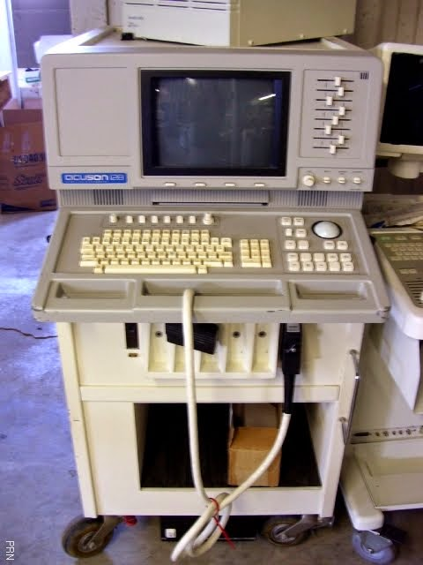
3. Hybrid Computers:
Hybrid computers incorporate the technology of both analog and digital computers.
These computers store and process analog signals which have been converted into discrete numbers using analog-to-digital converters.
They can also convert the digital numbers into analog signals or physical properties using digital-to-analog converters.
These computers are mainly used in artificial intelligence (robotics) & computer aided manufacturing (e.g. process control).

Slide 8
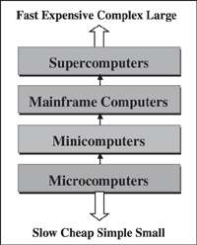
According to Size and Capacity

Slide 9
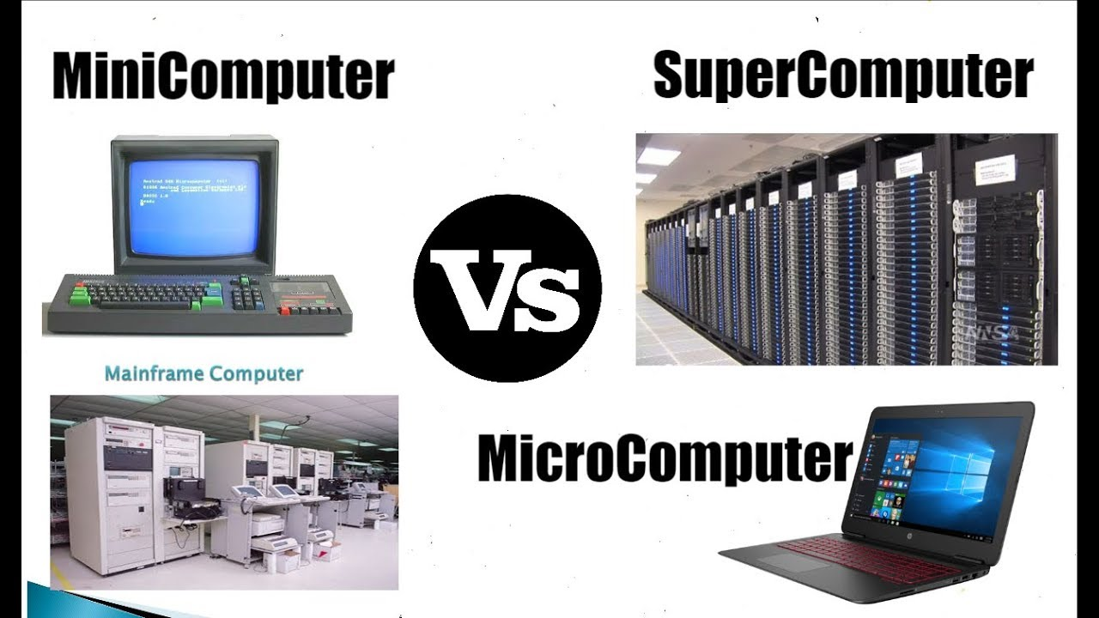

Slide 10
1. Microcomputers:
Small / low-cost / single-user digital computer.
They consist of CPU, input unit, output unit, storage unit and the software.
Microcomputers can be connected together to create a network of computers that can serve more than one user.
IBM PC based on Pentium microprocessor and Apple Macintosh are some examples of microcomputers.
Microcomputers include desktop computers, notebook computers or laptop, tablet computer, handheld computer, smart phones and net-book.
2. Minicomputers:
Multi-user systems.
High processing speed and high storage capacity than the microcomputers.
No of users 4–200.

Slide 11
The users can access the minicomputer through their PCs or terminal.
They are used for real-time applications in industries, research centers,
Example: PDP 11, IBM (8000 series).
Minicomputers are small computers that were introduced in 1960 and are used for various business enterprises and scientific applications work.
Microcomputers are kind of personal computers that are used for much general-purpose work and are introduced in 1970 to overcome most of the tasks.
Minicomputers were smaller, less expensive, and less powerful than a mainframe or supercomputer but more expensive and more powerful than a personal computer.
Minicomputers were used for scientific and engineering computations, business transaction processing, file handling, and database management.

Slide 12
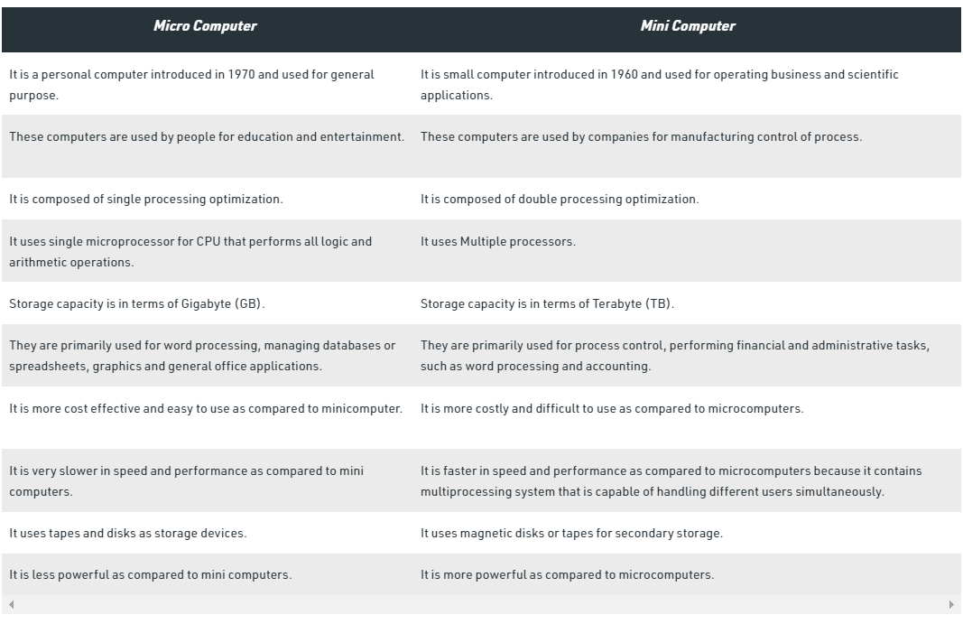

Slide 13
3. Mainframe Computers:
Multi-user/multi-programming/ and high performance computers.
High speed / large storage capacity.
Used in centralized databases.
The user accesses the mainframe computer via a terminal that may be a dumb terminal, an intelligent terminal or a PC.
Mainframe computers are used in organizations like banks or companies, where many people require frequent access to the same data.
Examples: are CDC 6600 and IBM ES000 series.
Indian railway use Mainframe Computers to interact with the customers for the various online functions.

Slide 14
4. Supercomputers:
Fastest and the most expensive machines.
High processing speed.
The speed of a supercomputer is measured in FLOPS (FLoating point Operations Per Second).
Supercomputers are built by interconnecting thousands of processors that can work in parallel.
Used for highly calculation-intensive tasks, such as, weather forecasting, biological research, nuclear research and aircraft design.
Examples:-
IBM Roadrunner, IBM Blue gene and Intel ASCI red.
PARAM is a series of supercomputer assembled in India by C-DAC (Center for Development of Advanced Computing), in Pune. PARAM Padma is the latest machine in this series. The peak computing power of PARAM Padma is 1 Tera FLOP (TFLOP).
Tainhe-2 (Milky way-2) China (33.86 TFLOP)
Titan- America (10 TFLOP)

